Slide 1

Design Classes: CLASS DIAGRAM
Design subsystems ➔ Package Diagram
Design classes ➔ Class Diagram
Use case realizations ➔ Sequence Diagram
Deployment diagram (implementation)

Slide 2
Anatomy of a Design Class
In analysis, we just capture the required behavior of the system without worrying at all about how this behavior is going to be implemented
In design, we have to specify exactly how the class will fulfill its responsibilities by doing the following:
  Complete the set of attributes and fully specify them including name, type, visibility and (optionally) a default value
  Turn the operations specified in the analysis class into a complete set of one or more methods
Note: In our SE scope, we only produce domain model in analysis without operations

Slide 3
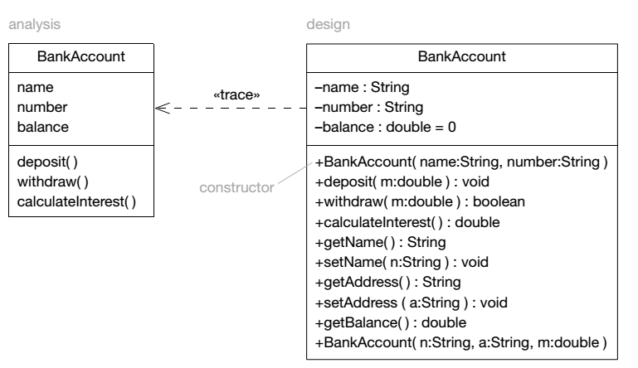
Analysis vs. Design Class
Note: In our SE scope, we only produce domain model in analysis without operations

Slide 4
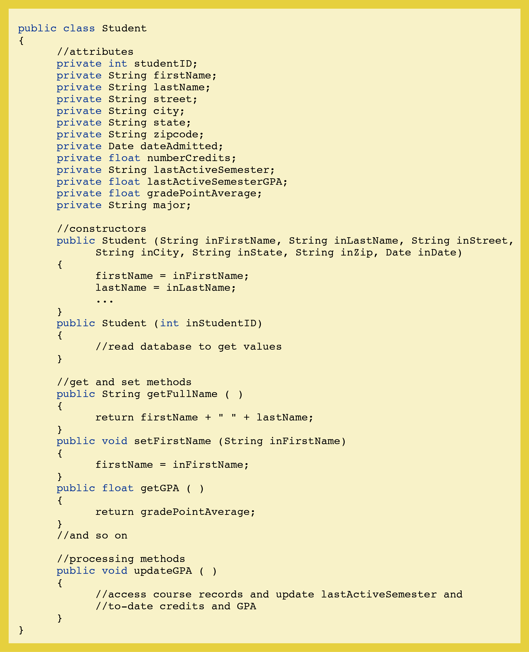
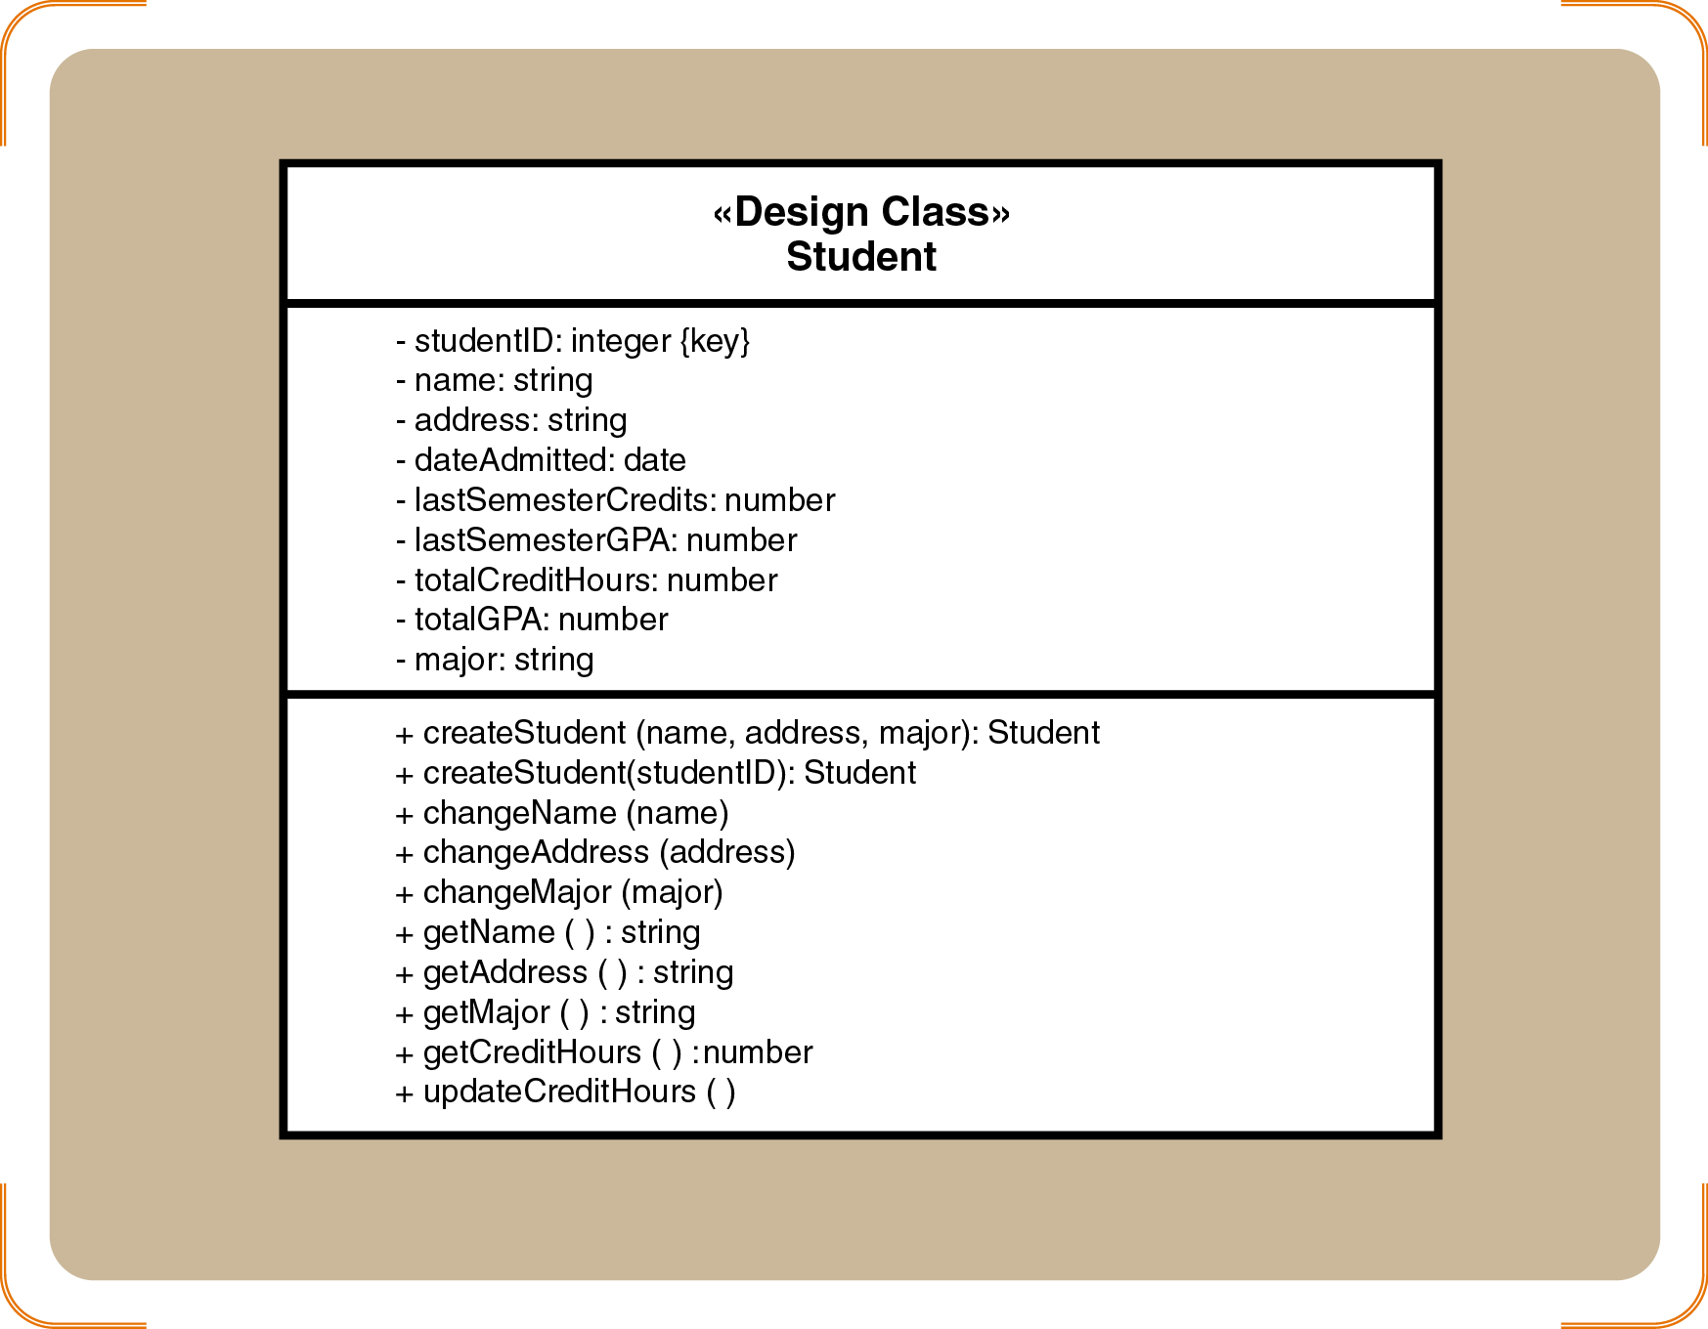
Design vs. Implementation

Slide 5
Design Class Symbols Using Stereotypes
Stereotypes
  UML notation to categorize a model element as a certain type
Two types of notation
  Full notation with guillemets («»)
  Shorthand notation with circular icons
Standard stereotypes
  Entity, control, boundary, data access
Note: This concept has been introduced in the analysis stage

Slide 6
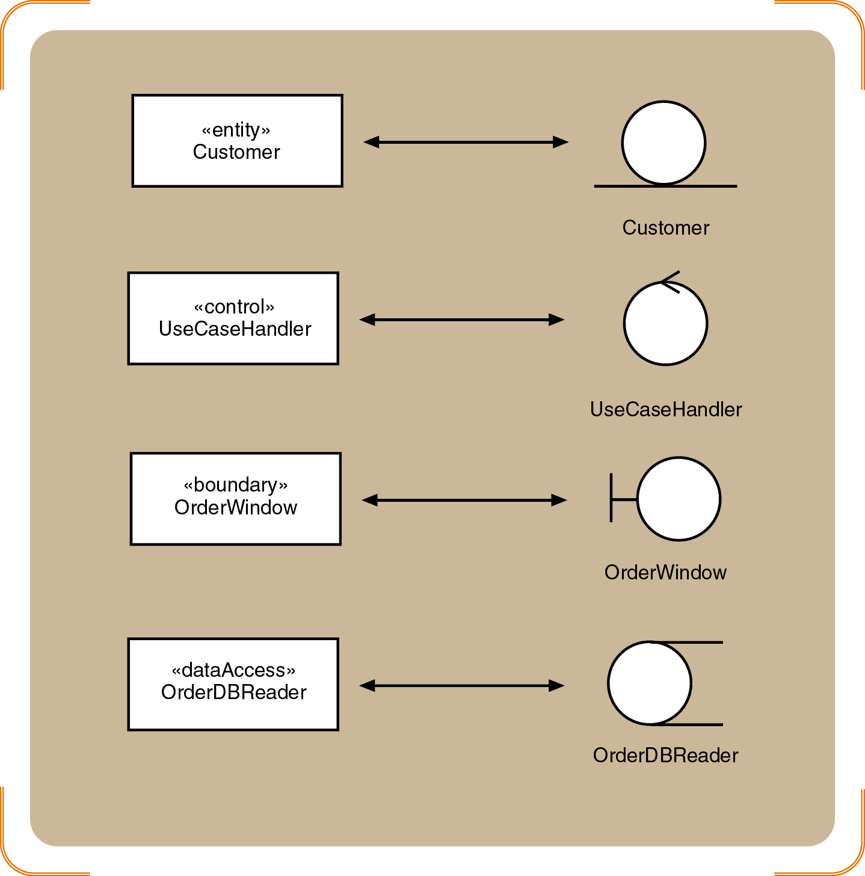
Standard Stereotypes in Design Models
Shorthand notation
Full notation

Slide 7
Design Class Notation
Class name and stereotype information
Attribute information
  Visibility, type-expression, name, initial value, and properties
Method signature
  Visibility, name, type-expression, and parameter list
  Use the entire signature to identify a method to distinguish between overloaded methods

Slide 8
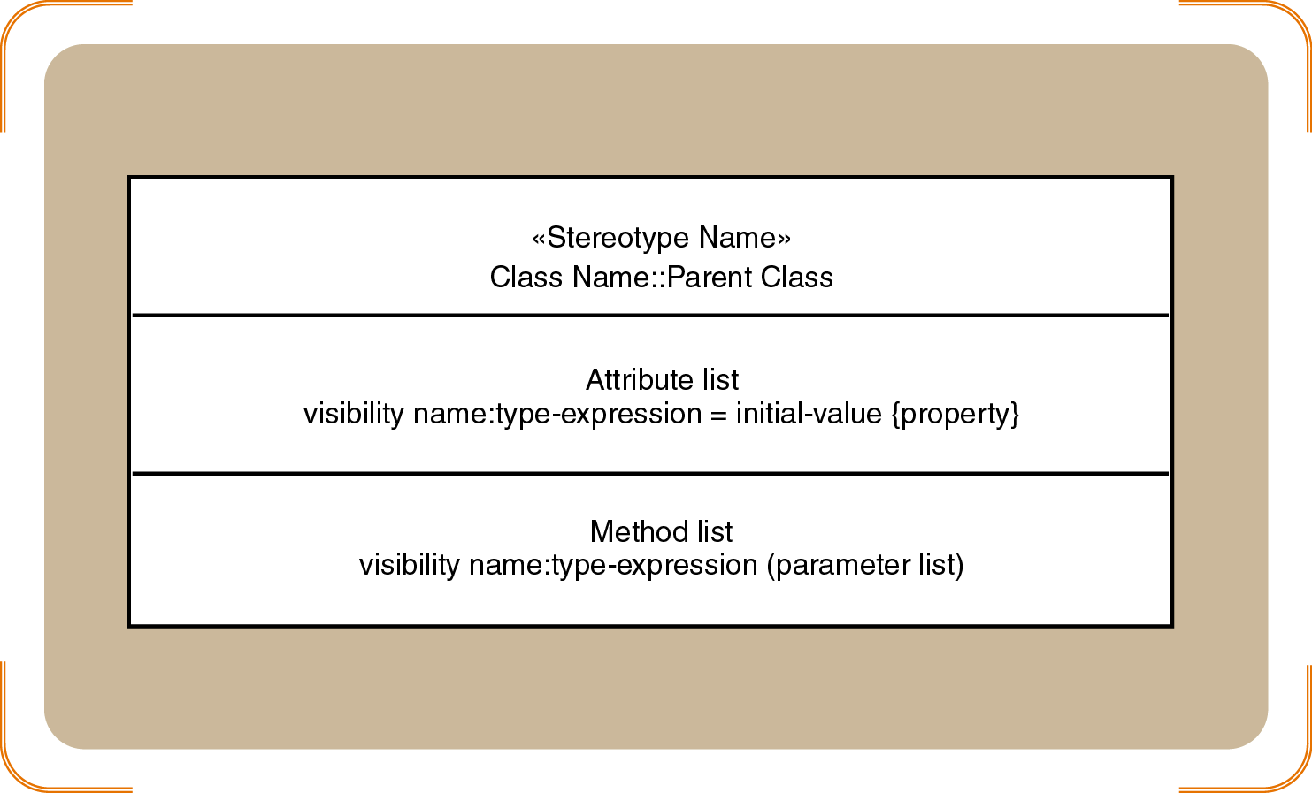
Internal Symbols and Example

Slide 9
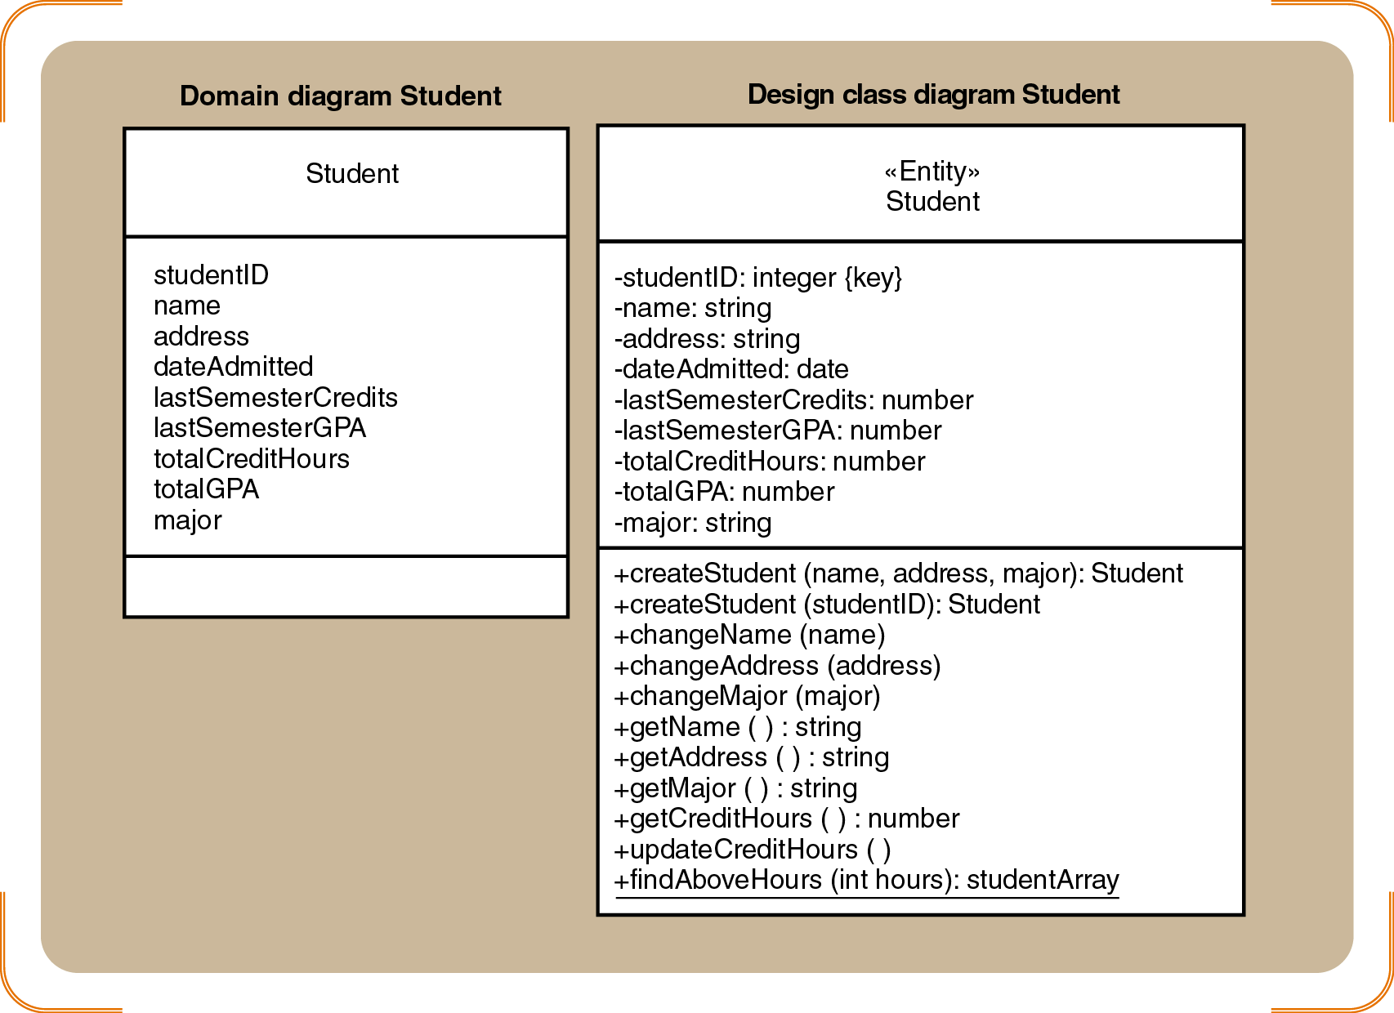
Domain Model vs. Design Class Diagram
Student class examples for the domain diagram and the design class diagram

Slide 10
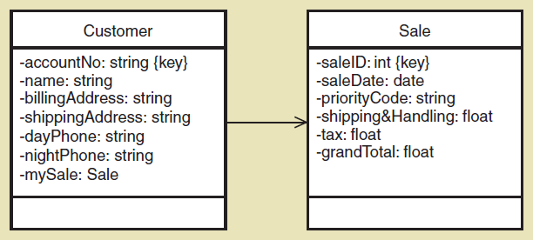
Navigation Visibility
The ability of one object to view and interact with another object accomplished by adding an object reference variable to a class
Shown as an arrowhead on the association line—customer can find and interact with sale because it has mySale reference variable

Slide 11
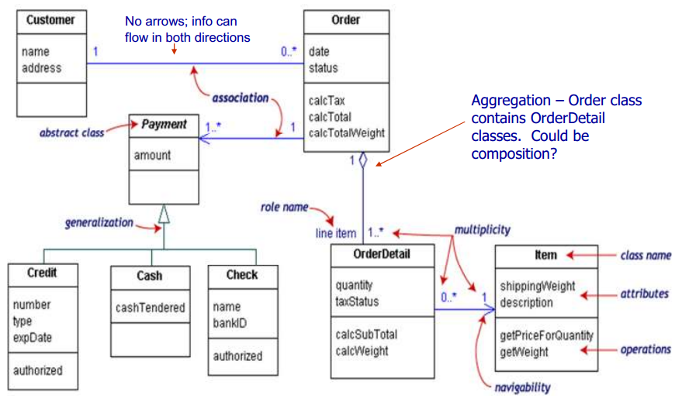
Example of Class Diagram with Navigability
Source: https://softwareengineering.stackexchange.com/questions/195614/uml-class-diagram-confusion?noredirect=1&lq=1

